Slide 2
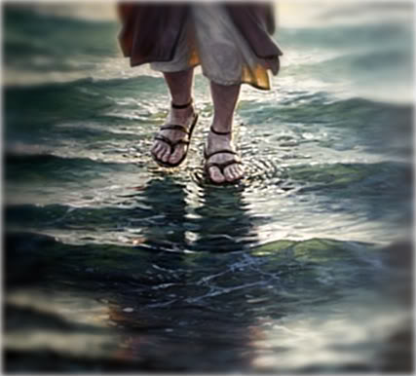
Can You Walk on Water?
(Matt. 14:22-33)

Slide 3
Can You Walk on Water?
(Matt. 14:22-33)
I. Get into the Boat! (ver. 22)

Slide 4
Can You Walk on Water?
(Matt. 14:22-33)
II. Don’t Let the Storms of Life Stop you! (vers. 23-25)
FOUR WATCHES
6:00 TO 9:00 2. 9:00 TO 12:00
3. 12:00 TO 3:00 4. 3:00 TO 6:00
Mark 13:35
Watch ye therefore: for ye know not when the master of the house cometh, at even, or at midnight, or at the cockcrowing, or in the morning:

Slide 5
Can You Walk on Water?
(Matt. 14:22-33)
III. Cast aside All Fear! (vers. 26-27)
2 Tim 1:6-7
6 Therefore I remind you to stir up the gift of God which is in you through the laying on of my hands. 7 For God has not given us a spirit of fear, but of power and of love and of a sound mind. NKJV

Slide 6
Can You Walk on Water?
(Matt. 14:22-33)
III. Cast aside All Fear! (vers. 26-27)
Rom 8:15-17
15 For you did not receive the spirit of slavery to fall back into fear, but you have received the Spirit of adoption as sons, by whom we cry, "Abba! Father!" 16 The Spirit himself bears witness with our spirit that we are children of God, 17 and if children, then heirs—heirs of God and fellow heirs with Christ, provided we suffer with him in order that we may also be glorified with him.

Slide 7
Can You Walk on Water?
(Matt. 14:22-33)
IV. Desire to Do Something Great for the Lord! (ver. 28)

Slide 8
Can You Walk on Water?
(Matt. 14:22-33)
V. Get Out of the Boat! (ver. 29)

Slide 9
Can You Walk on Water?
(Matt. 14:22-33)
VI. Keep Our Focus on Christ! (ver. 30)

Slide 10
Can You Walk on Water?
(Matt. 14:22-33)
Get into the Boat! (ver. 22)
Don’t Let the Storms of Life Stop you! (vers. 23-25)
Cast aside All Fear! (vers. 26-27)
Desire to Do Something Great for the Lord! (ver. 28)
Get Out of the Boat! (ver. 29)
Keep Our Focus on Christ! (ver. 30)

